Slide 1
UP Post-Doctoral Management Application
SoftServe Group

Slide 2
WHAT IS A POST DOCTORAL FELLOW?
A Post-Doctoral fellow is a person who conducts research after they have completed their PhD, with the aim of deepening their knowledge in a specific field.
This is a growing field in Universities around South Africa.
The University of Pretoria,
UP, supports such research opportunities in order to increase the research output of UP itself. Post-Doctoral fellows who conduct their research at UP do so under the supervision of an appropriate academic staff member at the University and their research may be externally or internally funded.

Slide 3
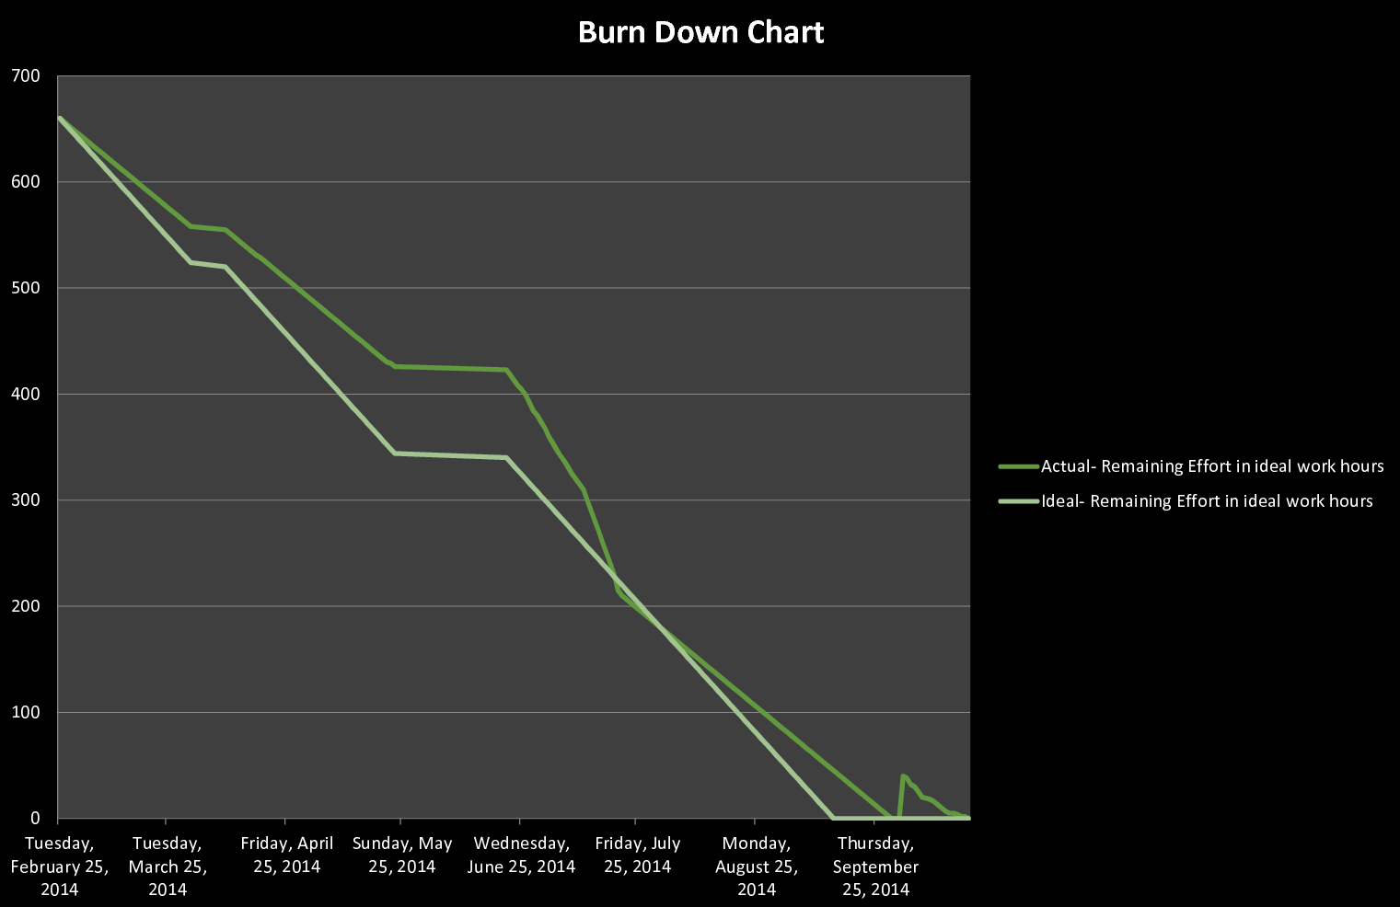
BURN DOWN CHART

Slide 4
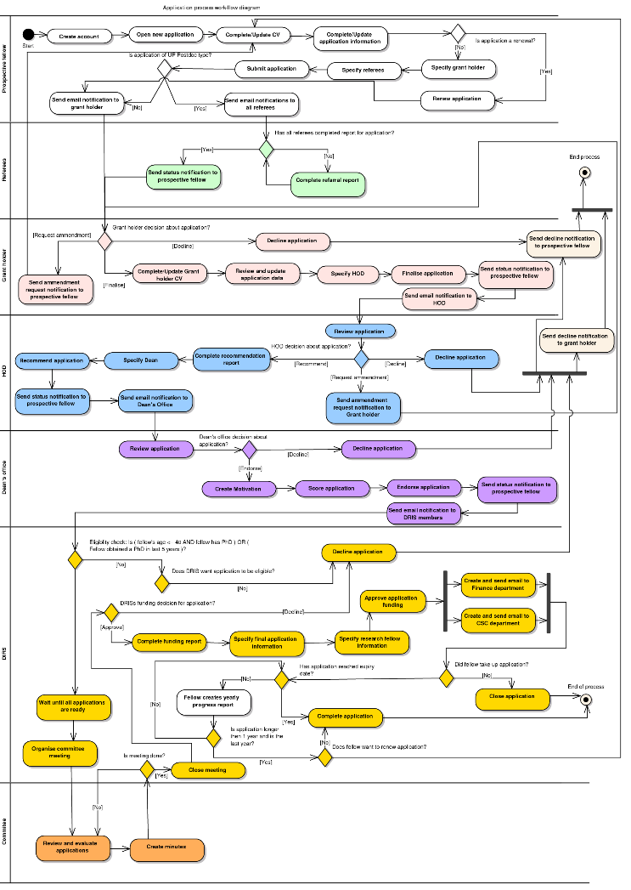

Slide 5
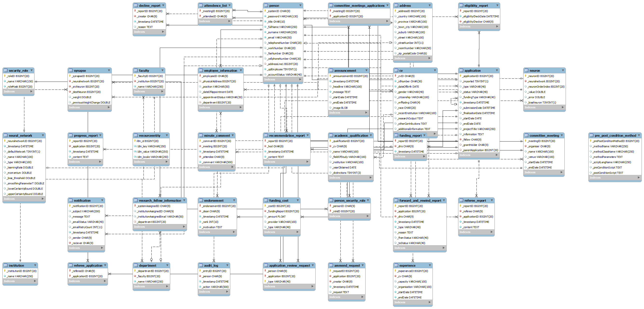

Slide 6
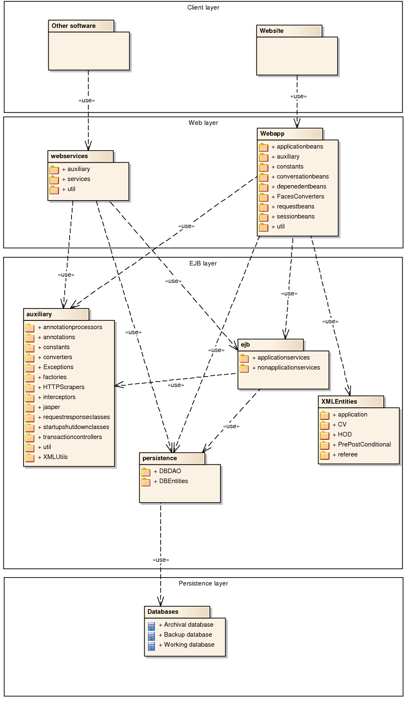

Slide 7
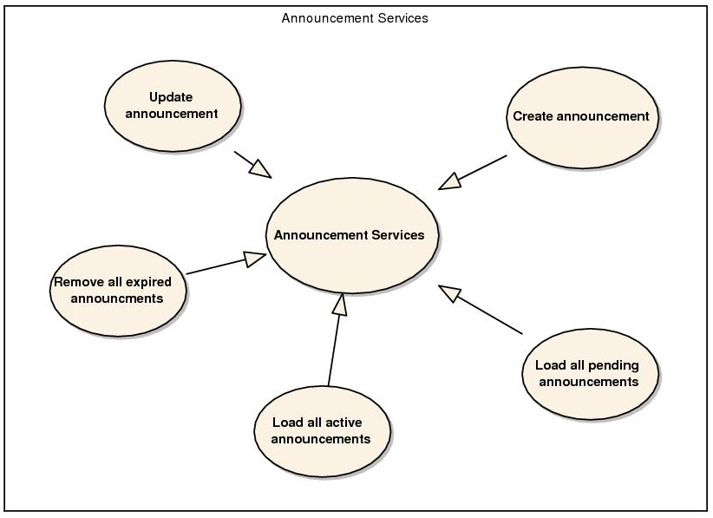

Slide 8
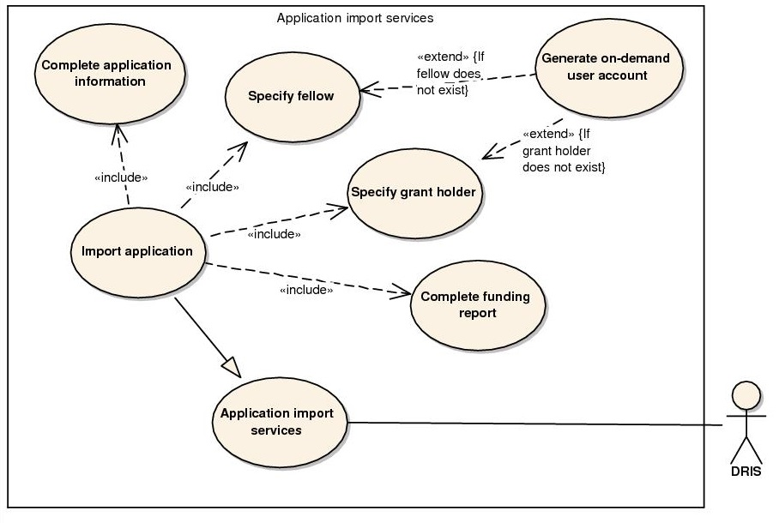

Slide 9
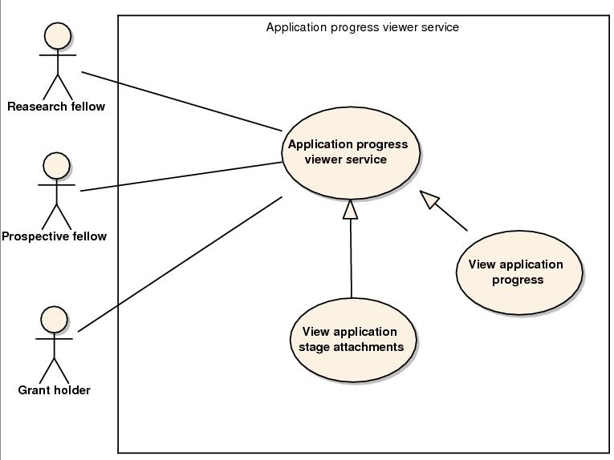

Slide 10
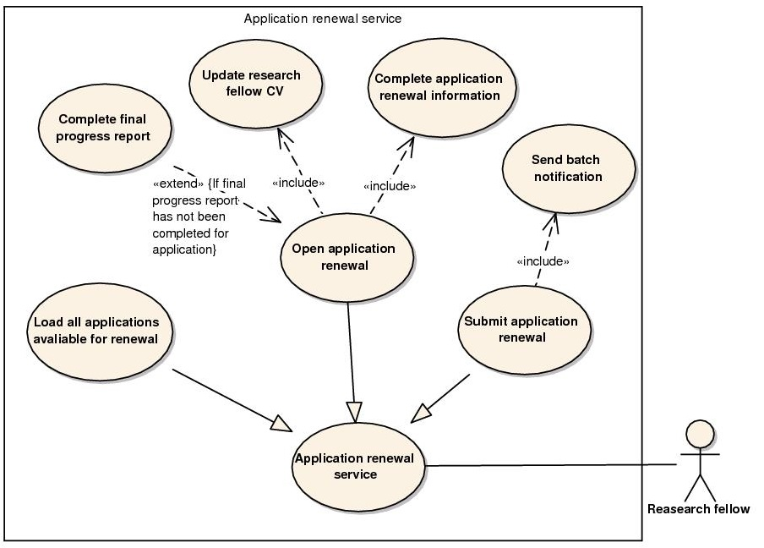

Slide 11
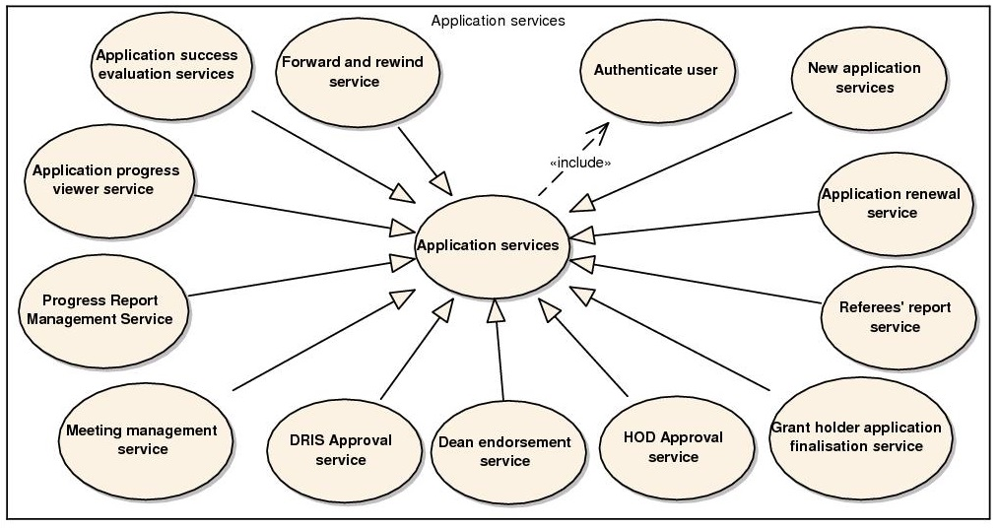

Slide 12
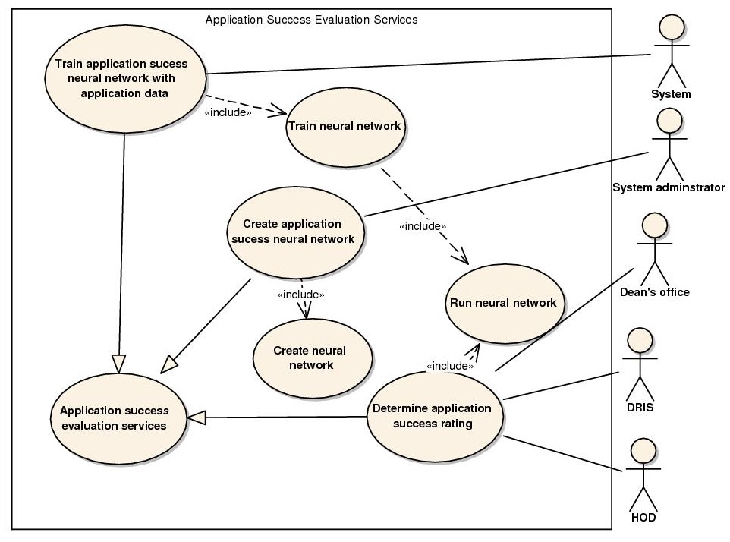

Slide 13
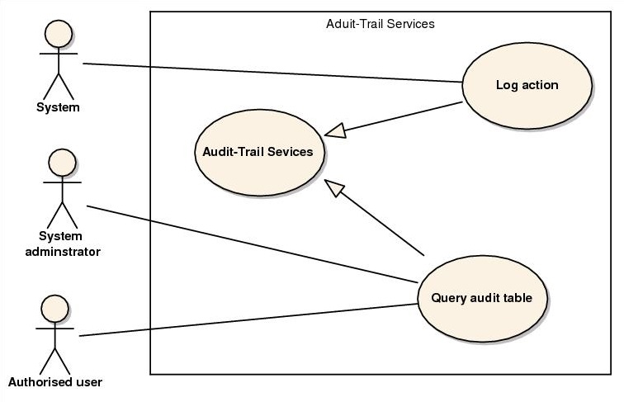

Slide 14
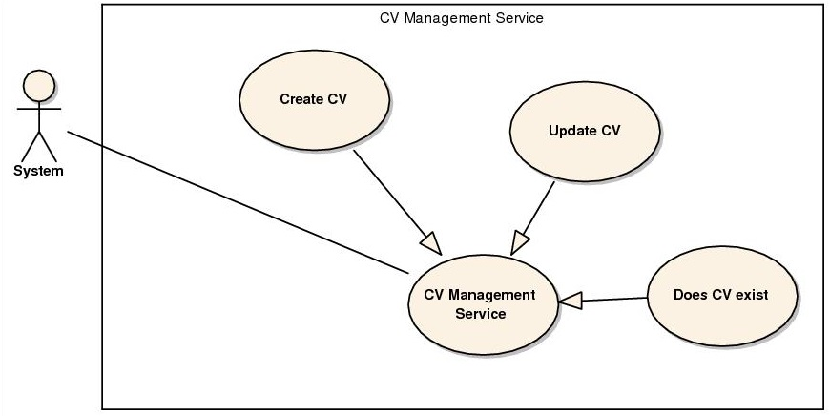

Slide 15
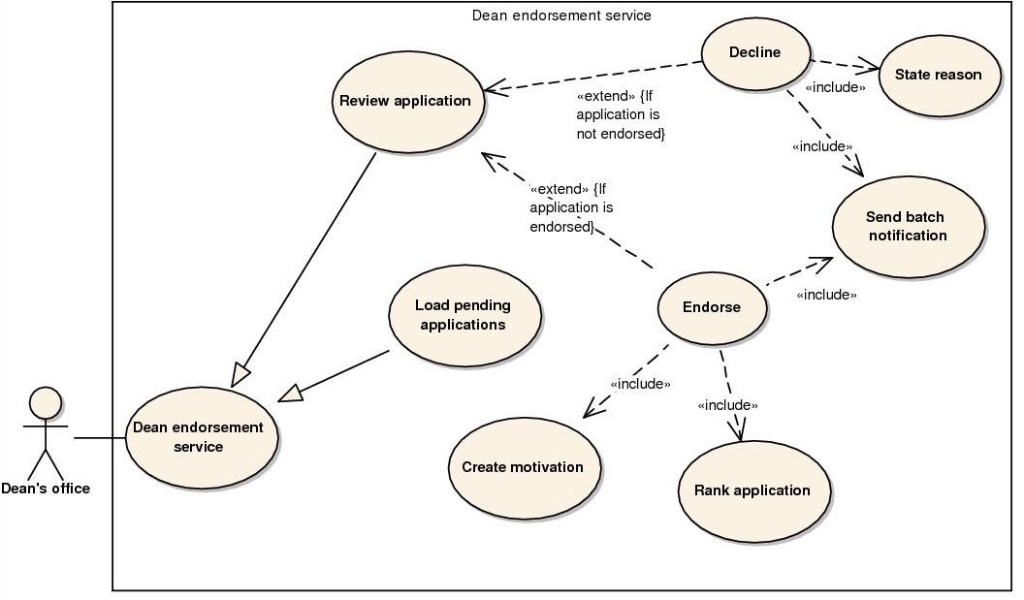

Slide 16
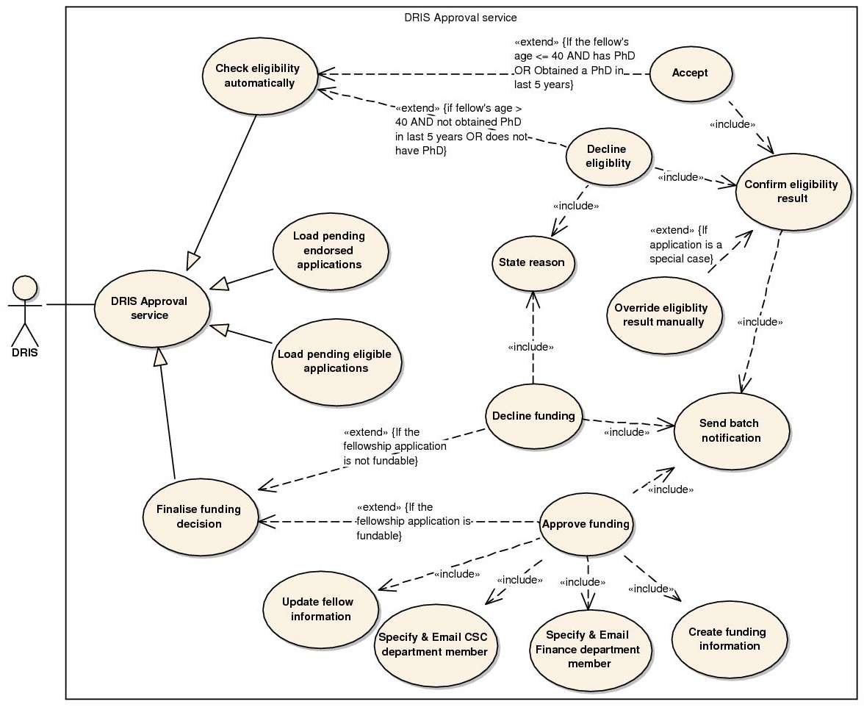

Slide 17
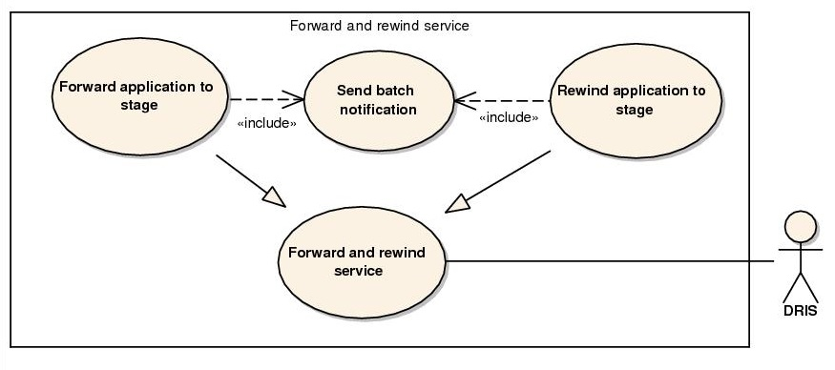

Slide 18
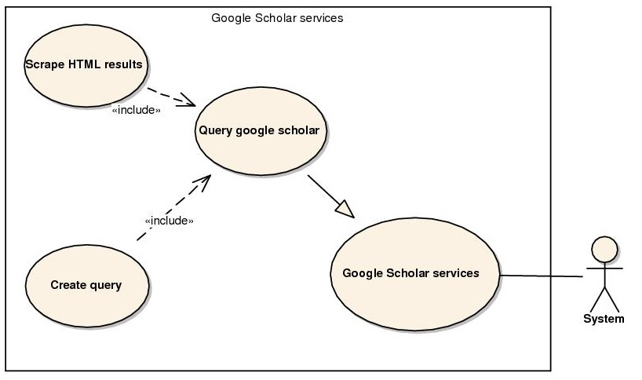

Slide 19
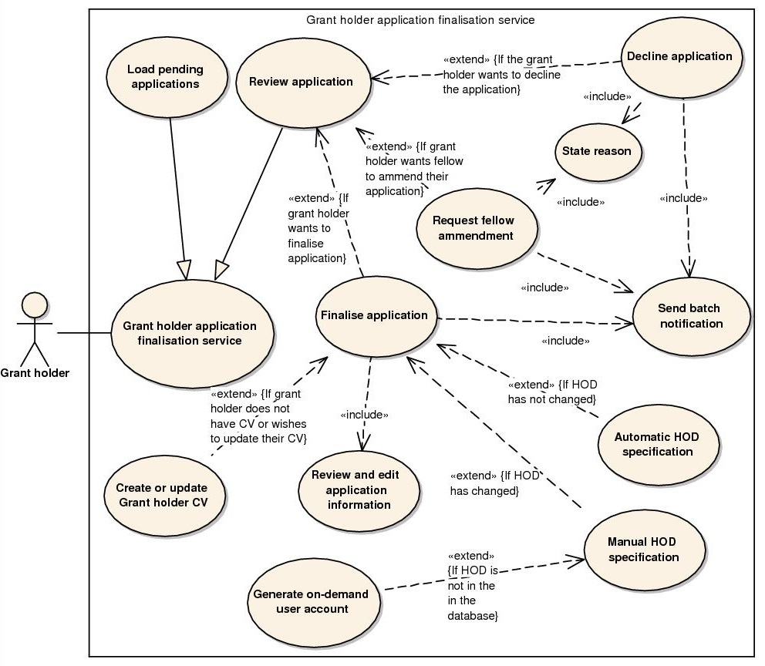

Slide 20
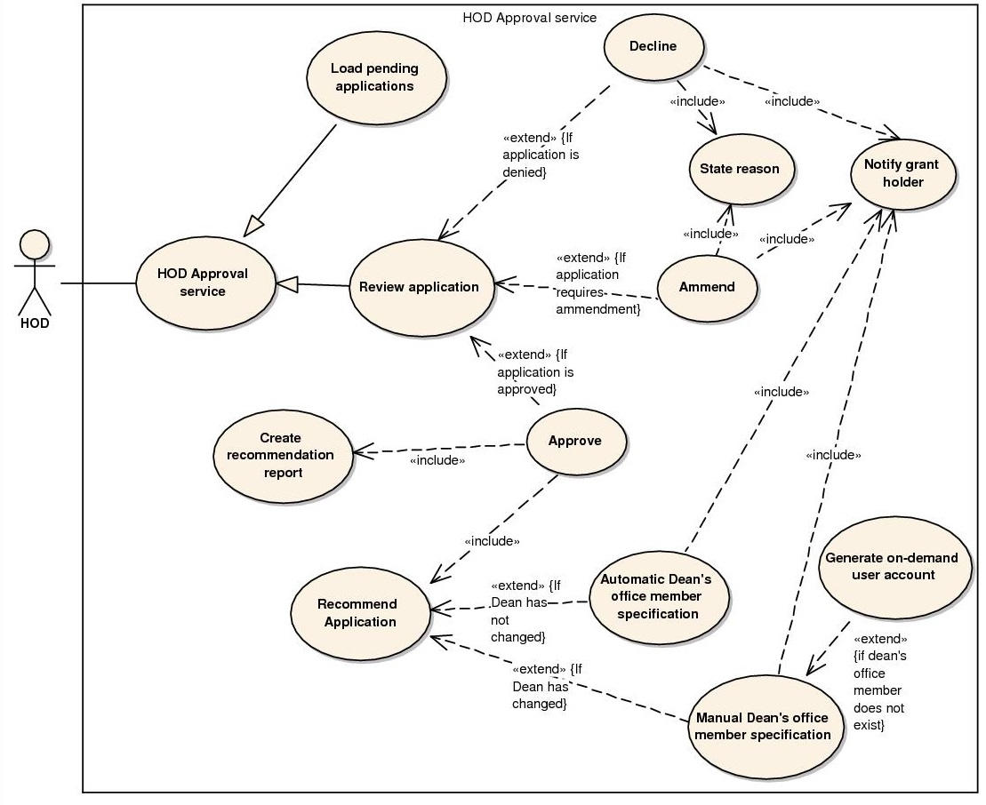

Slide 21
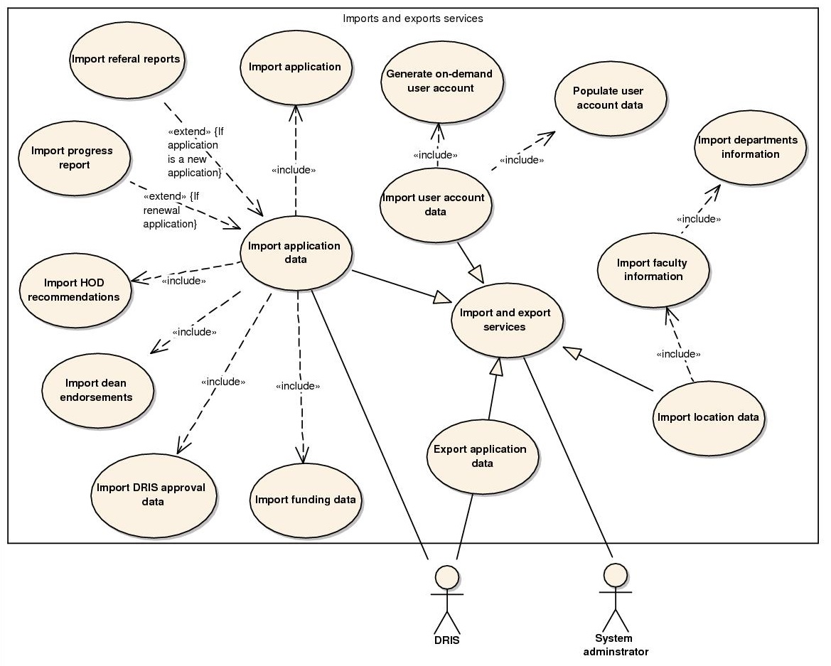

Slide 22
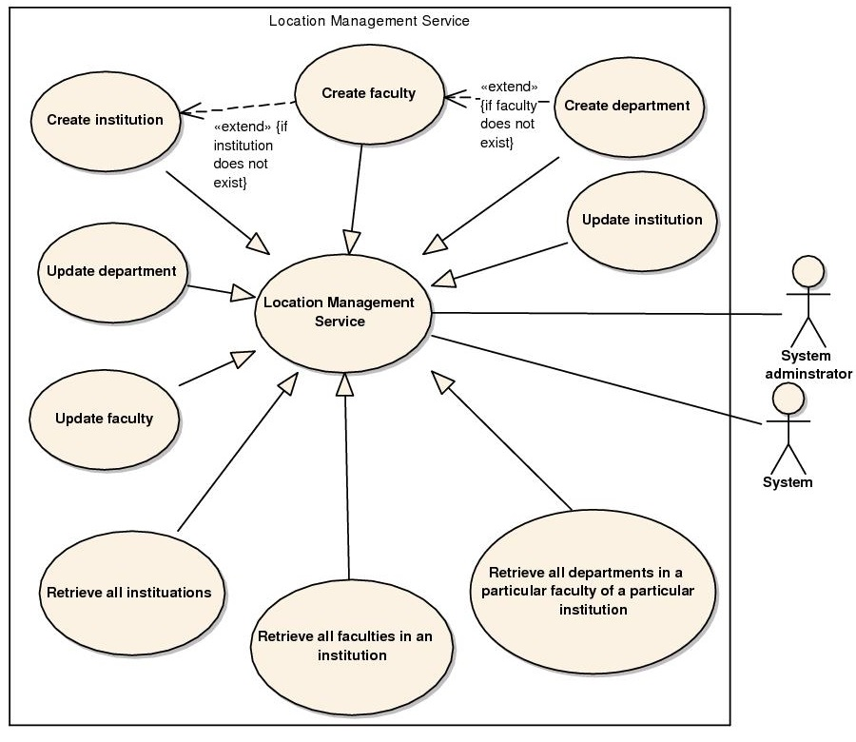

Slide 23
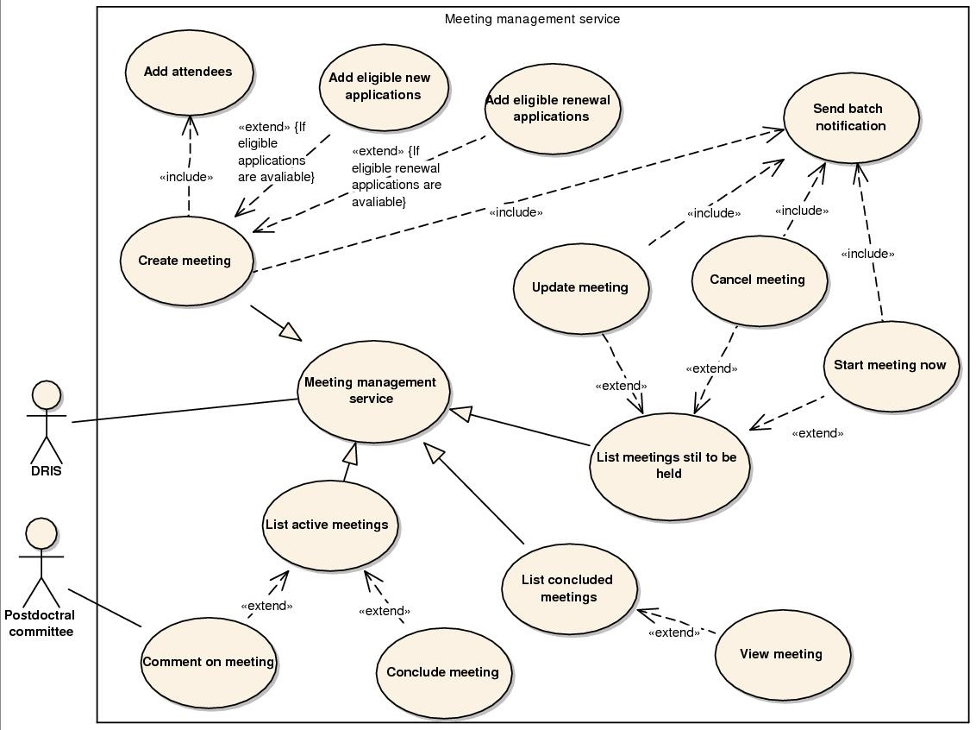

Slide 24
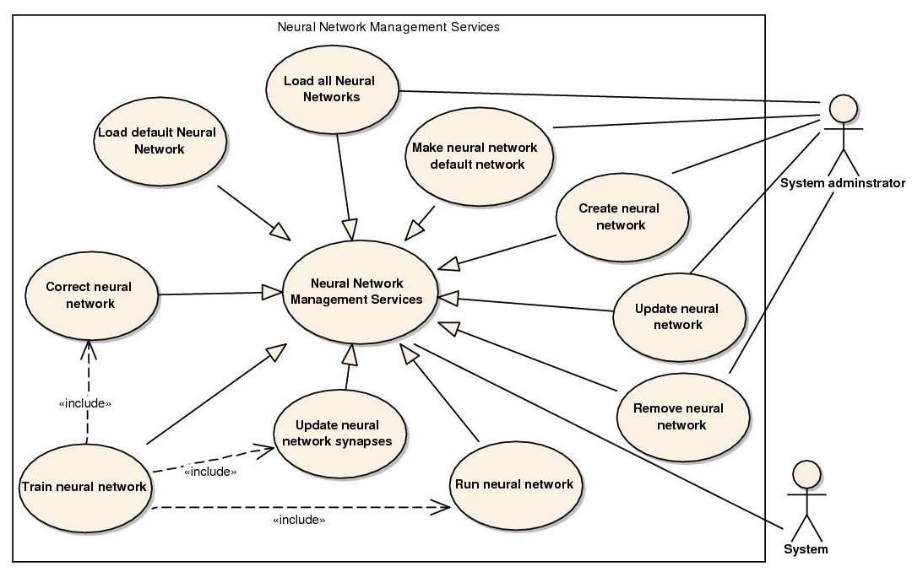

Slide 25
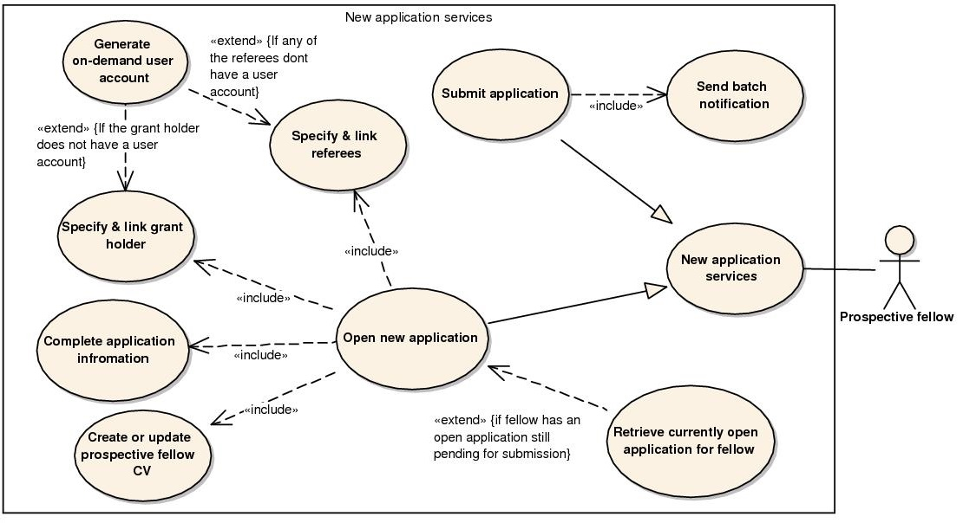

Slide 26
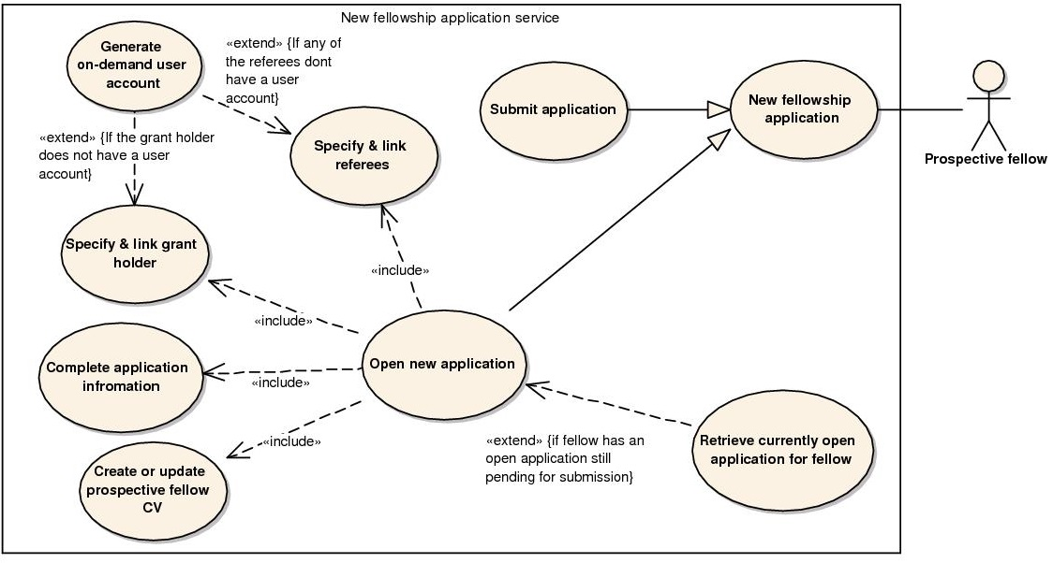

Slide 27
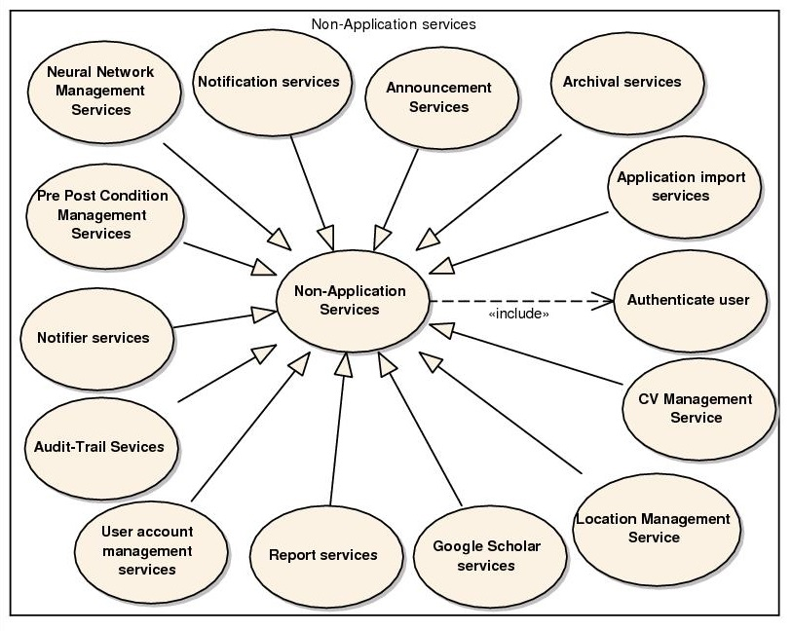

Slide 28
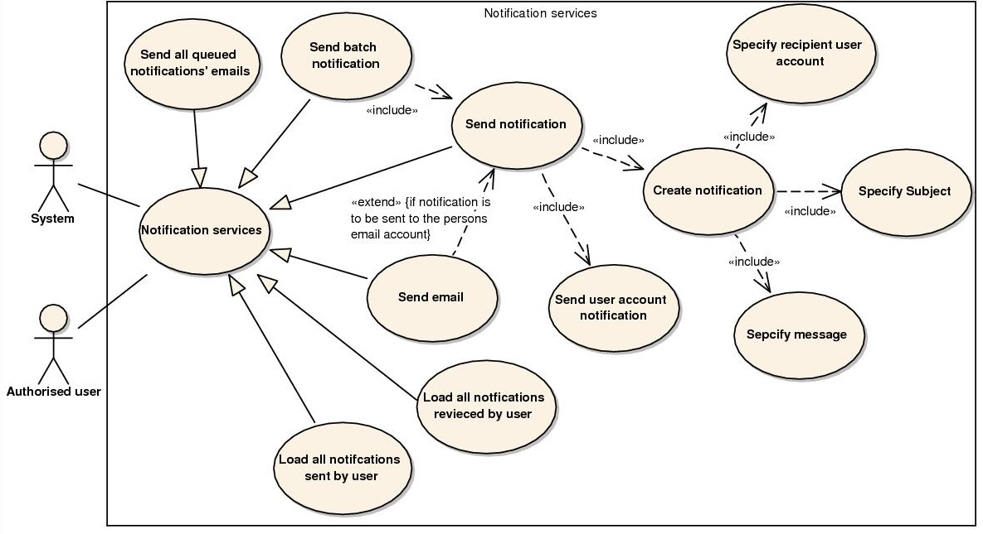

Slide 29
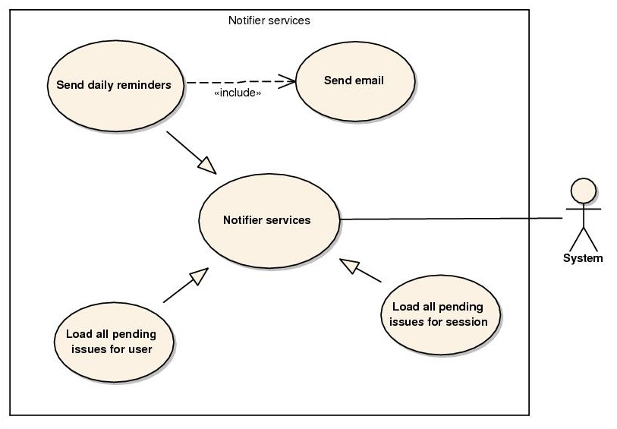

Slide 30
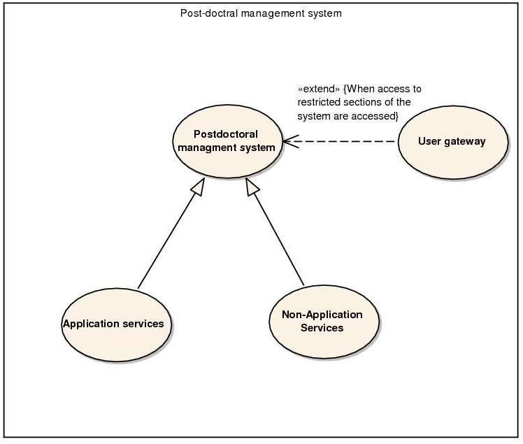

Slide 31
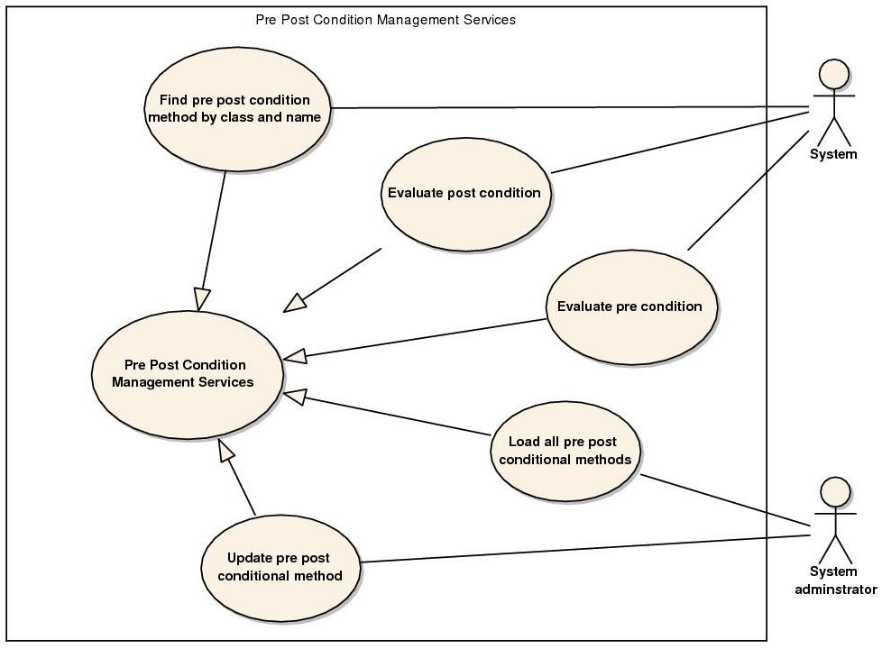

Slide 32
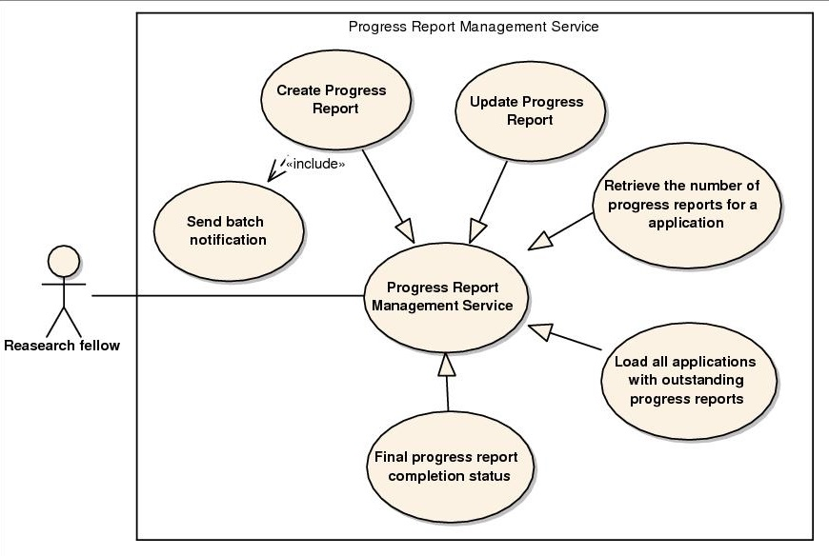

Slide 33
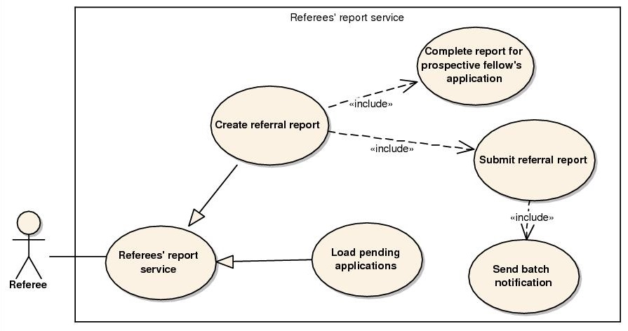

Slide 34
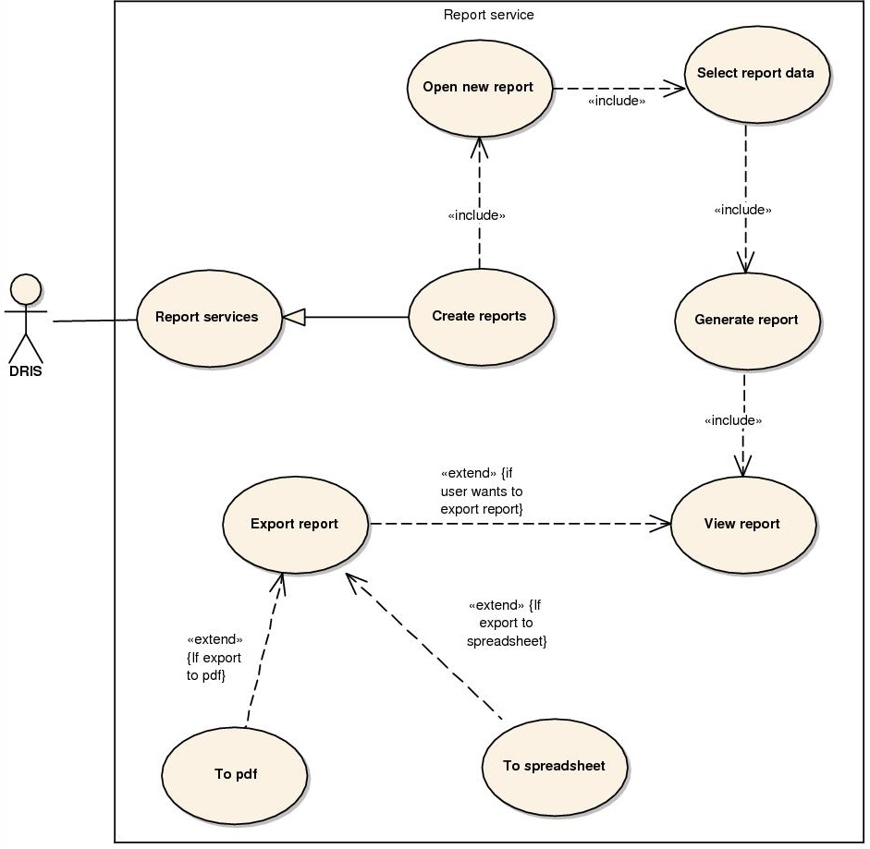

Slide 35
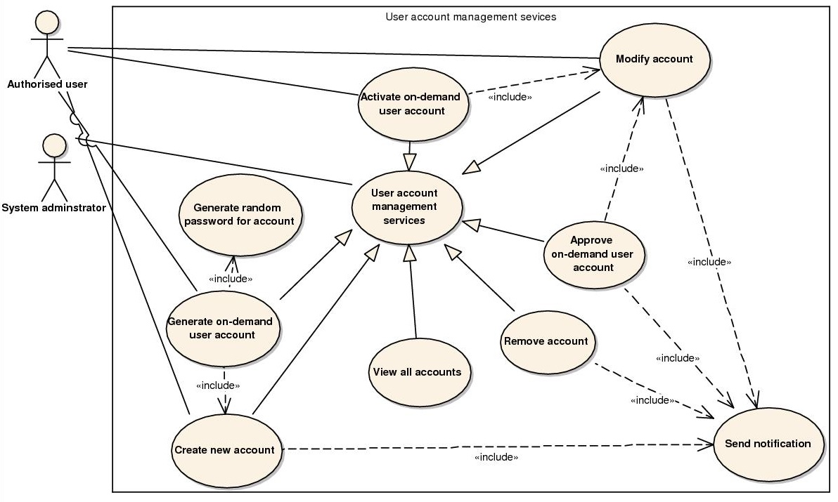

Slide 36
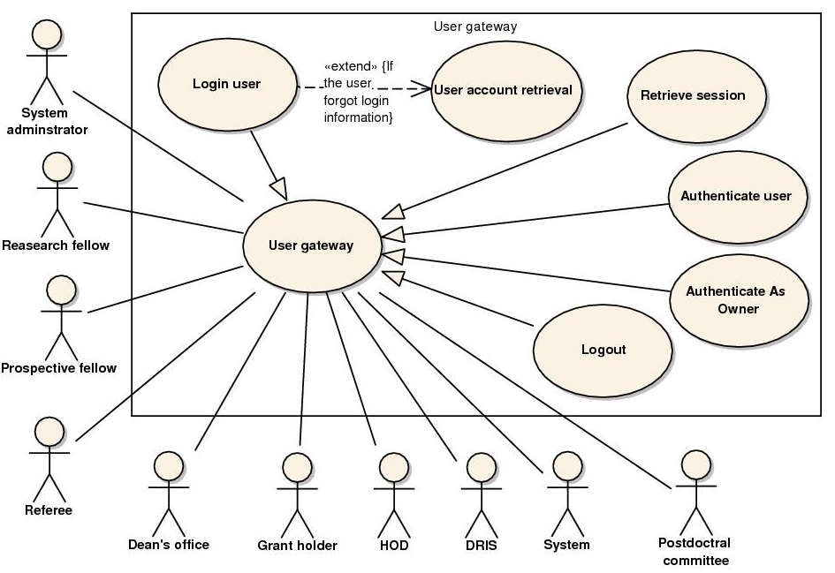

Slide 37
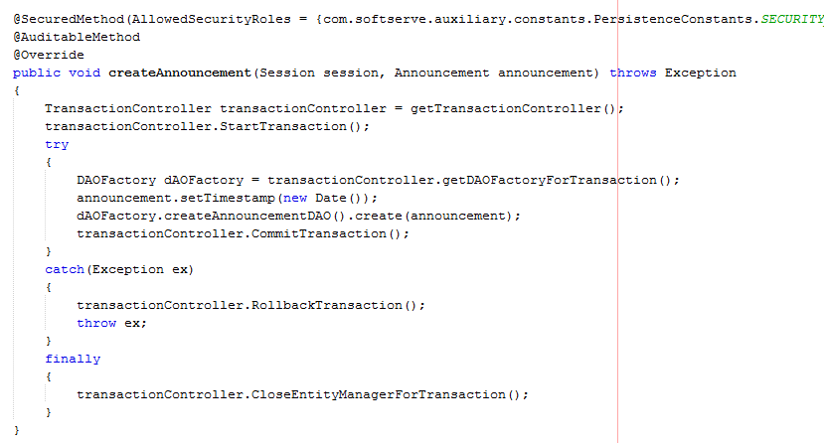
CODE SAMPLE

Slide 38
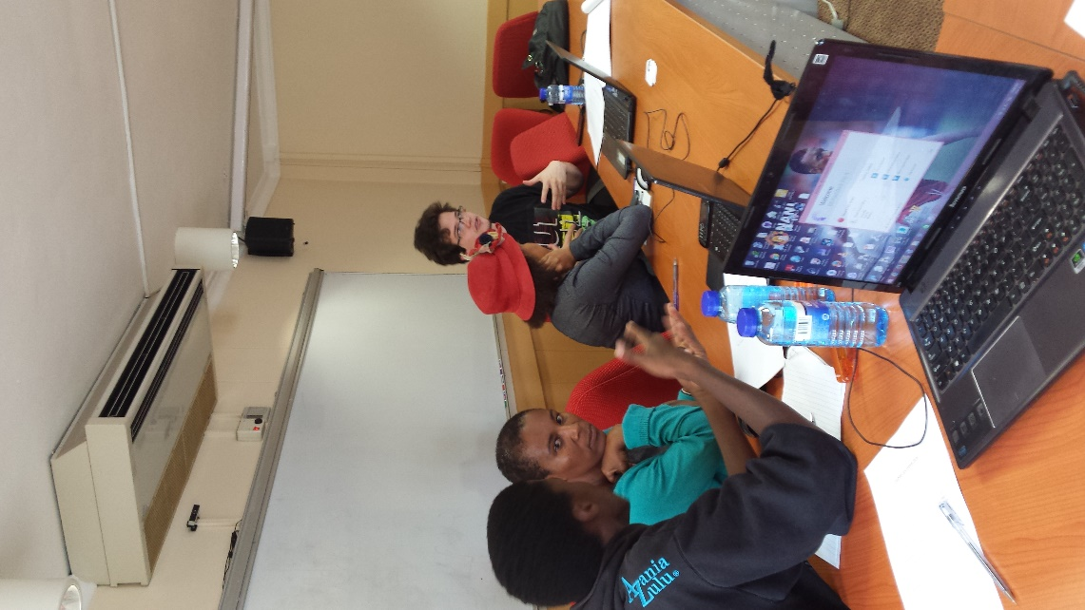
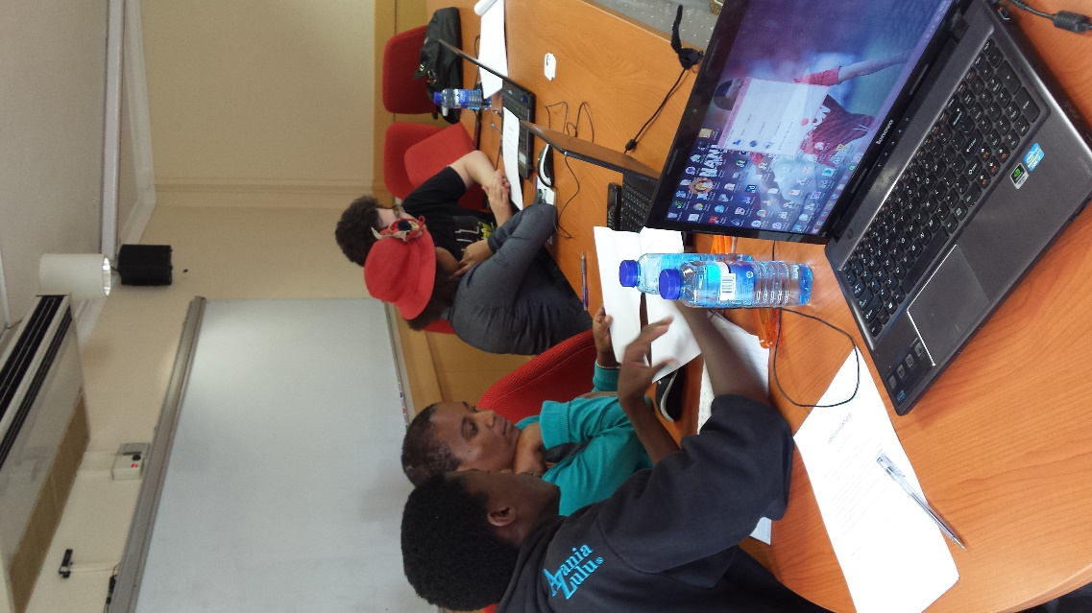
USABILITY TESTS

Slide 39
CHALLENGES FACED and OVERCOMING THEM
Learning Java EE and JSF for the first time
Research on Java EE from the Internet and Literature available

Slide 40
CHALLENGES FACED and OVERCOMING THEM
Getting familiar with various new technologies and frameworks. No clear cut online guides.
Research on Java EE from the Internet and Literature available

Slide 41
CHALLENGES FACED and OVERCOMING THEM
Found that some uses cases had to be added, modified and removed due to not previously thought scenarios.
Refining the uses case after consultation with the client

Slide 42
CHALLENGES FACED and OVERCOMING THEM
Holidays
Better time management

Slide 43
CHALLENGES FACED and OVERCOMING THEM
Various frustrating bugs created by a misunderstanding of technologies.
Debugging and research into the technologies

Slide 44
CHALLENGES FACED and OVERCOMING THEM
Lots of research
More Research

Slide 45
CHALLENGES FACED and OVERCOMING THEM
No API for Google scholar
Created our own API using HTML Scrapping

Slide 46
CHALLENGES FACED and OVERCOMING THEM
Misunderstandings with regards to JPA
Research into JPA and it’s best usage

Slide 47
CHALLENGES FACED and OVERCOMING THEM
Health concerns
Team members visited medical professionals

Slide 48
CHALLENGES FACED and OVERCOMING THEM
Looking for possible awe factors
Added Neural Networks and Google Scholar API

Slide 49
CHALLENGES FACED and OVERCOMING THEM
XML validation and maintainability of system
Research into ways to improving maintainability

Slide 50
CHALLENGES FACED and OVERCOMING THEM
Getting the most out of Jasper and using it’s resource files.
Switched to Dynamic Jasper, an extension of Jasper.

Slide 51
CHALLENGES FACED and OVERCOMING THEM
Juggling other school work.
Better time management and a few all nighter’s

Slide 52
CHALLENGES FACED and OVERCOMING THEM
Implementing client requested changes without breaking code.
Numerous Code refactoring, as well as changes to the User Interfaces

Slide 53
CHALLENGES FACED and OVERCOMING THEM
Using group member’s skills to the best of their ability
Finding out their strengths and allowing them to work on areas related to their strengths

Slide 54
CHALLENGES FACED and OVERCOMING THEM
Finding a server for the client to host the system
Helping the client look at alternatives and making a proposal for it.

Slide 55
CHALLENGES FACED and OVERCOMING THEM
Finding funds to pay for all the printing.
Hopefully by winning a few prizes to help cover the costs

Slide 56
BENEFITS OF THE SYSTEM
Provides a centralised location where all the Post Doctoral Information is held
Removes the need for a paper based system.
It can operate on any Web Browser (mobile or computer or tablet).
Designed to be similar to the current UP system.

